Slide 1
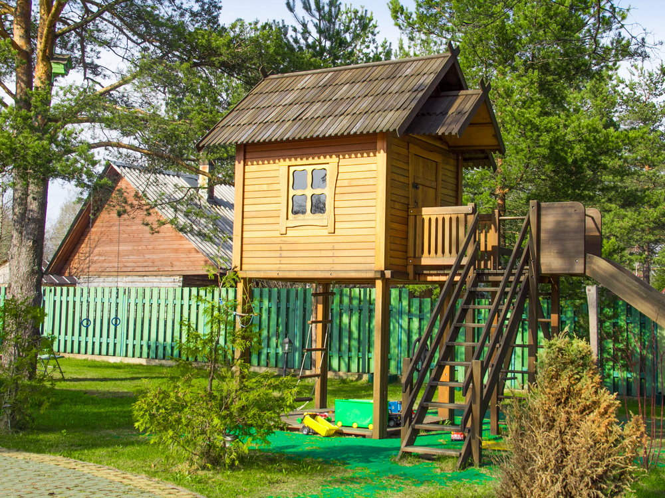
My Playhouse

Slide 2
My Playhouse #1
When I was younger my dad built my brother and I a playhouse in our backyard. We had many exciting adventures there and played several games. In the summer, we sometimes slept there. I have many great memories of my playhouse. It is very symbolic for me.

Slide 3
My Playhouse #2
My dad built that playhouse with his own two hands. It was one of his first big construction projects. I remember that he had a secret compartment in it where he hid a silver dollar for my brother and I to find. We never could figure it out. The day before he sold it, he took us inside and showed us where the hiding spot was. That playhouse symbolizes all the hard-work and time my dad spent trying to create uniqueness and wonder for us growing up. It is a trait I try to have as a parent.

